Slide 1
Working with Dates
By Binayak Basu

Slide 2
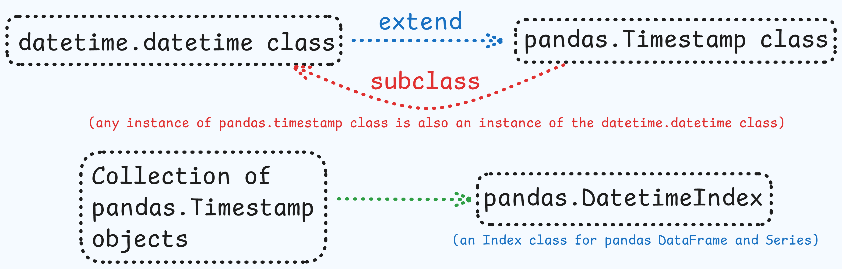
datetime.datetime, pd.Timestamp & pd.DatetimeIndex

Slide 3
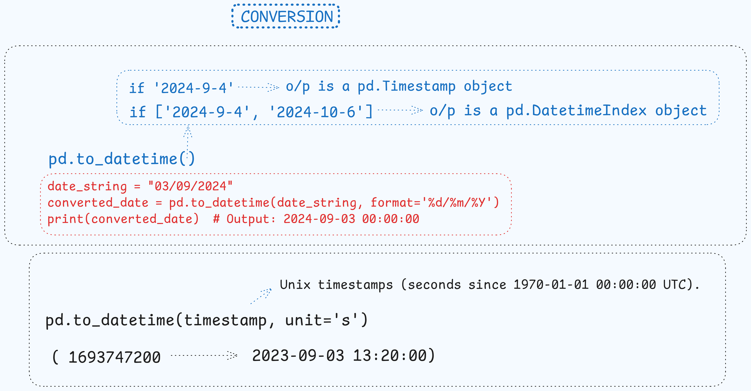
pd.to_datetime()

Slide 4
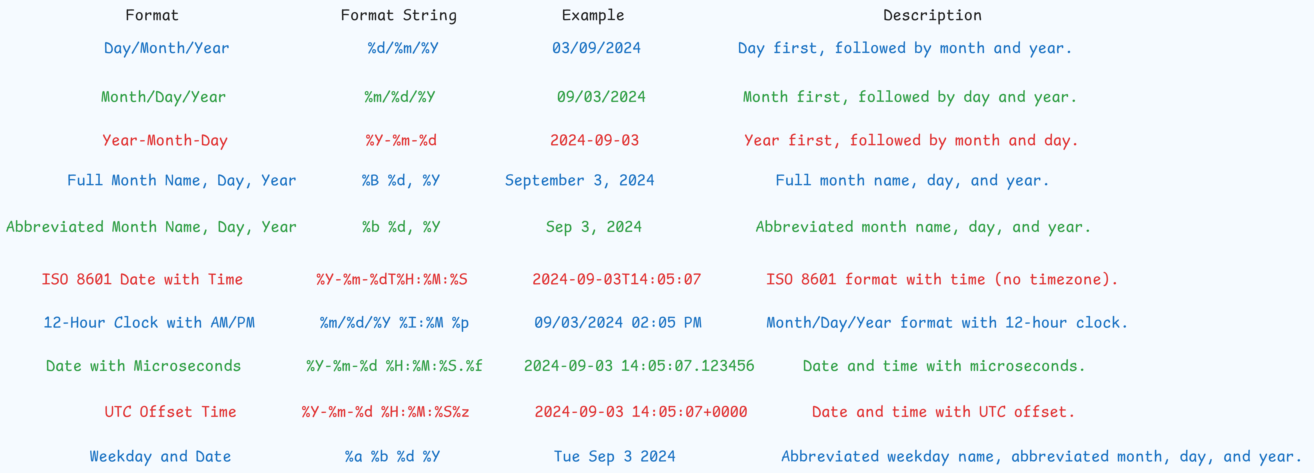
Different Formats of Dates

Slide 5
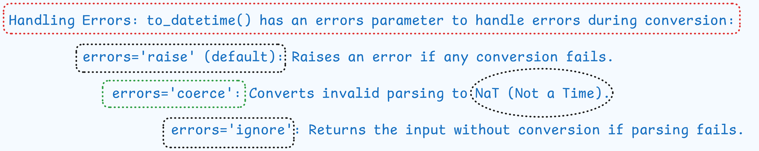
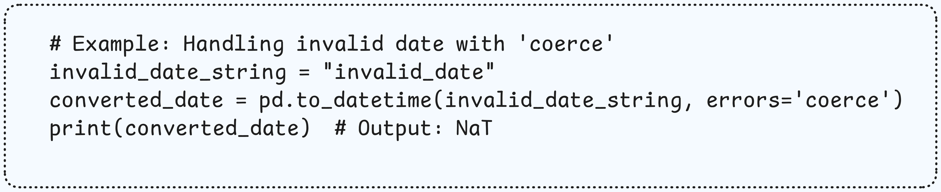
Handle Errors in pd.to_datetime()

Slide 6
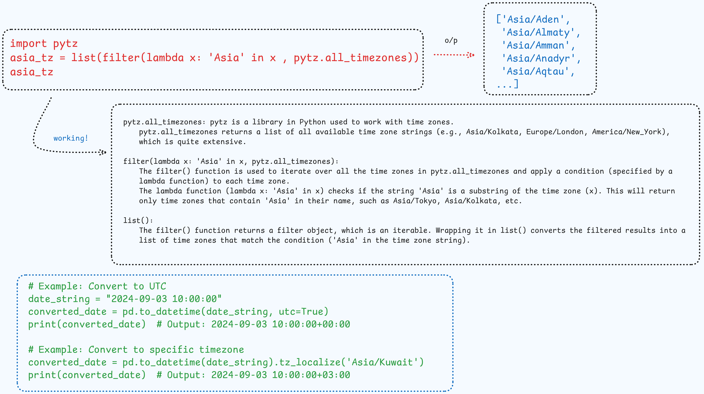
Dealing with Time Zones

Slide 7
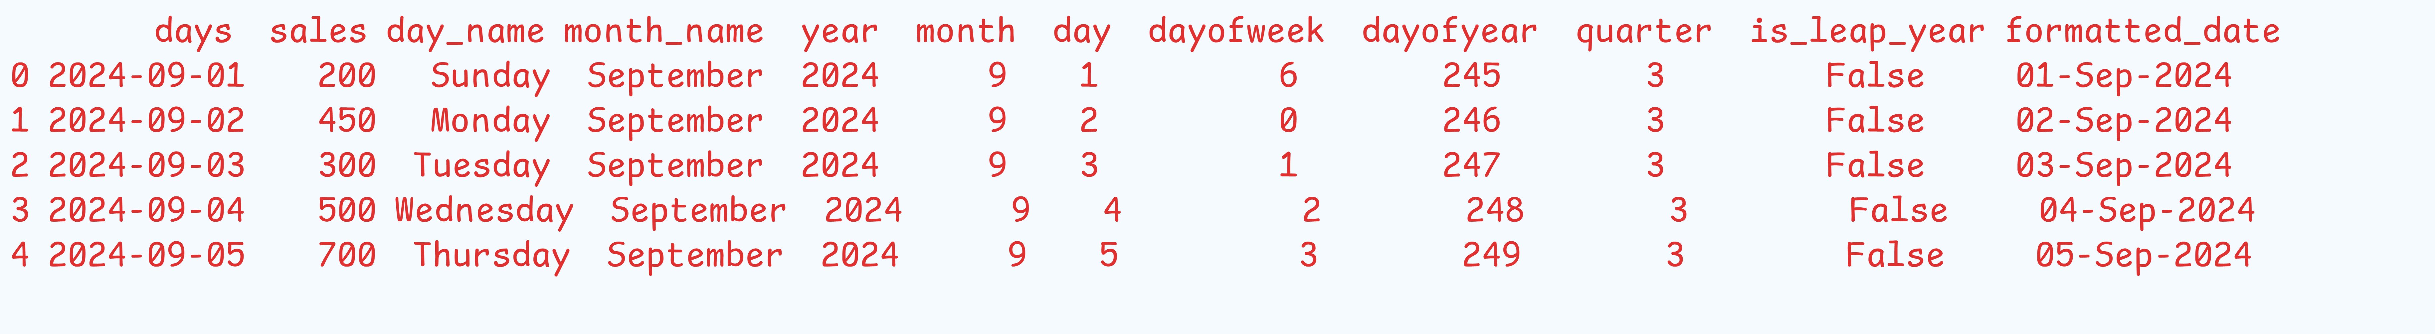
DatetimeIndex Functions

Slide 8
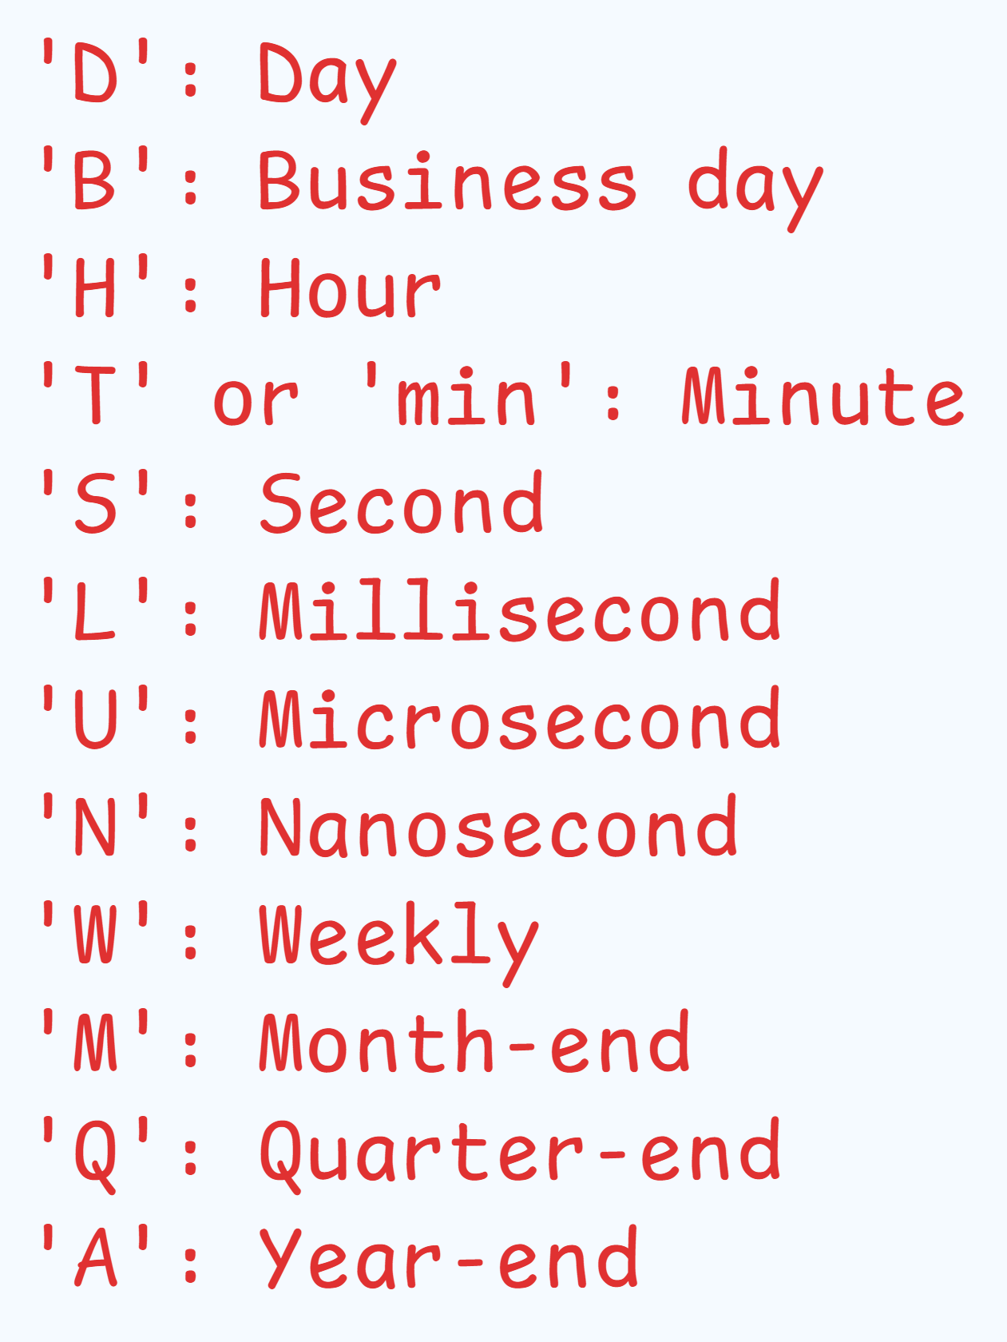
pandas.date_range()
The pandas.date_range() function is used to generate a sequence of dates (or a range of dates) with a specified frequency. It is particularly useful for creating time series data, building a timeline, or working with financial data that requires regular time intervals. The date_range() function returns a DatetimeIndex object, which is an index containing datetime objects.
Key Parameters of date_range
start: The starting date of the range. You can pass a string, a datetime.datetime object, or a pandas.Timestamp.
end: The ending date of the range. Similar to start, this can be a string, datetime.datetime, or pandas.Timestamp.
periods: Specifies the number of periods (or number of dates) to generate. If periods is specified, end is not needed.
freq: Frequency of the dates to generate. The default is daily ('D'), but it can be set to various other frequencies, such as 'H' for hourly, 'M' for month-end, 'B' for business day, etc.
tz: Time zone information. You can specify a time zone string (like 'UTC' or 'America/New_York').
normalize: If set to True, normalizes the start and end dates to midnight (00:00:00).
inclusive : {"both", "neither", "left", "right"}, default "both"
freq

Slide 9
Creating a Time Series Data

Slide 10
pd.Period object
pd.Period is a pandas object used to represent a single time period, such as a specific month, day, or year. Unlike a single datetime value, which represents an exact point in time (including both date and time), a Period represents a time span or interval (such as "March 2024" or "2024 Q1"). This makes it particularly useful when working with time series data where you are interested in periods rather than exact timestamps.
Key Features of pd.Period
Represents a Time Interval: A Period object represents a span of time, such as a month, quarter, or year, rather than an exact timestamp. This is useful for data analysis focused on aggregated or period-based data (like monthly sales, quarterly revenues, etc.).
Supports Different Frequencies: You can specify the frequency of the period, such as daily (D), monthly (M), yearly (A or Y), and many others. This allows you to define what kind of period you are working with.
Arithmetics and Operations: You can perform arithmetic operations (like addition and subtraction) with periods. For example, you can add or subtract a number to a Period object to get a new period.
D: Day
M: Month-end
Q: Quarter-end
A: Year-end (Annual frequency)
H: Hour
T or min: Minute
S: Second
B: Business day

Slide 11
Pandas.PeriodIndex object with pd.period_range()
Usage with PeriodIndex : pd.Period objects are often used to create a PeriodIndex for a pandas DataFrame, which is particularly useful in time series analysis.

Slide 12
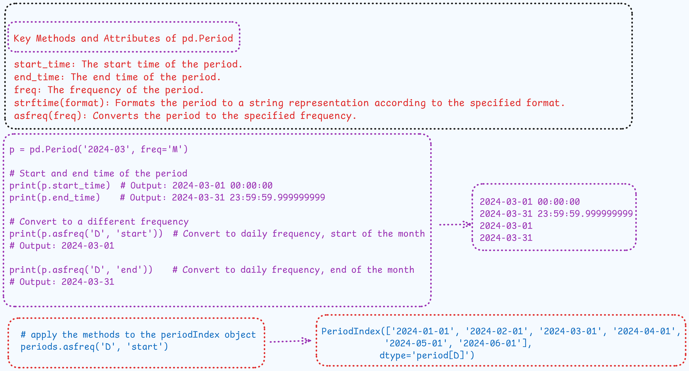
Key attributes of pd.Period and pd.PeriodIndex object

Slide 13
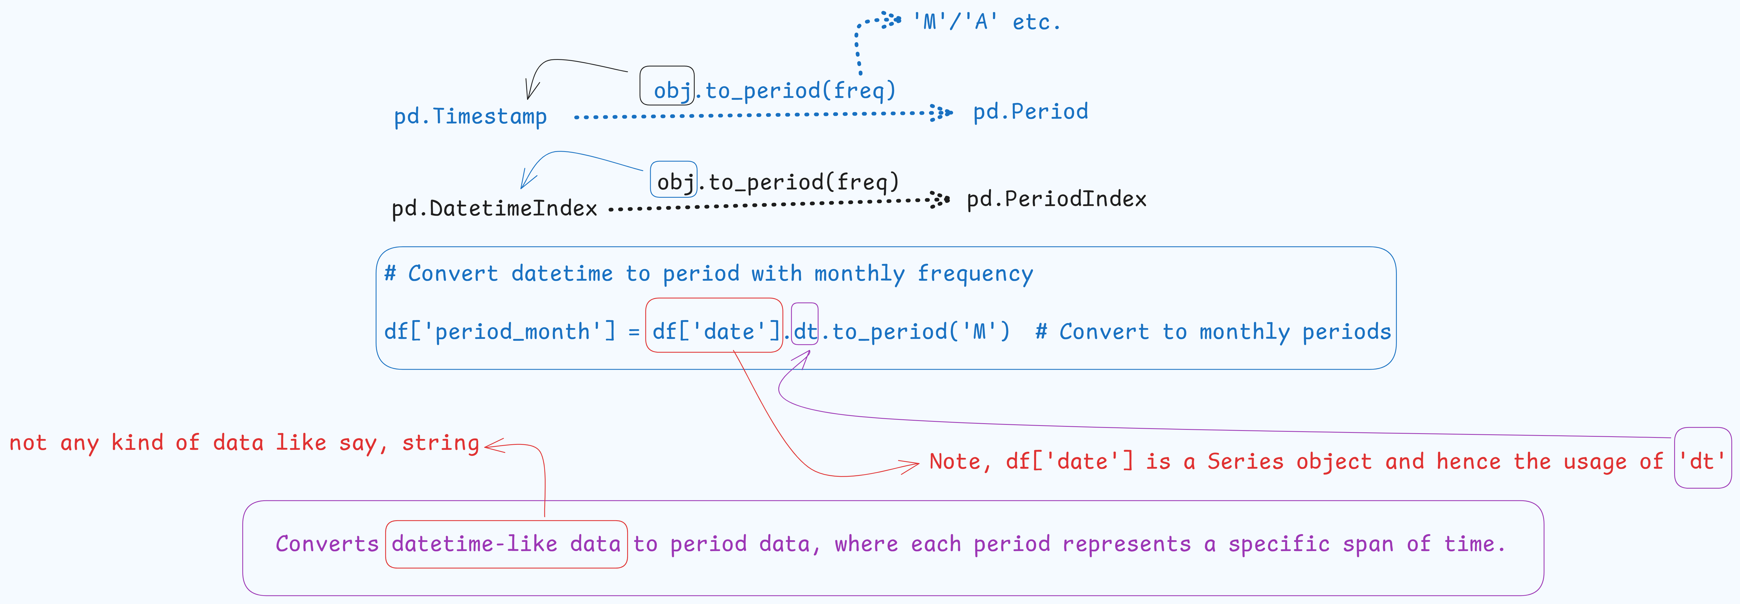
to_period(freq)

Slide 14
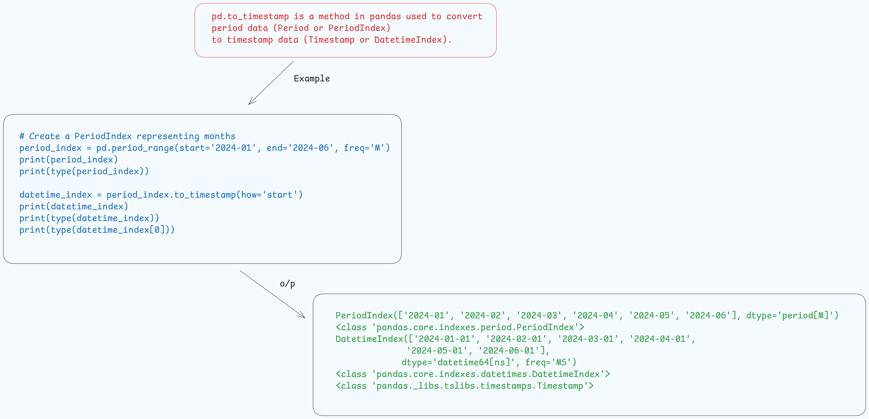
to_timestamp()

